Slide 1
Task 2
Internship Studio’s Ethical Hacking Internship
Name : Deep Kakadiya
E-mail: imyourdad0120@gmail.com

Slide 2
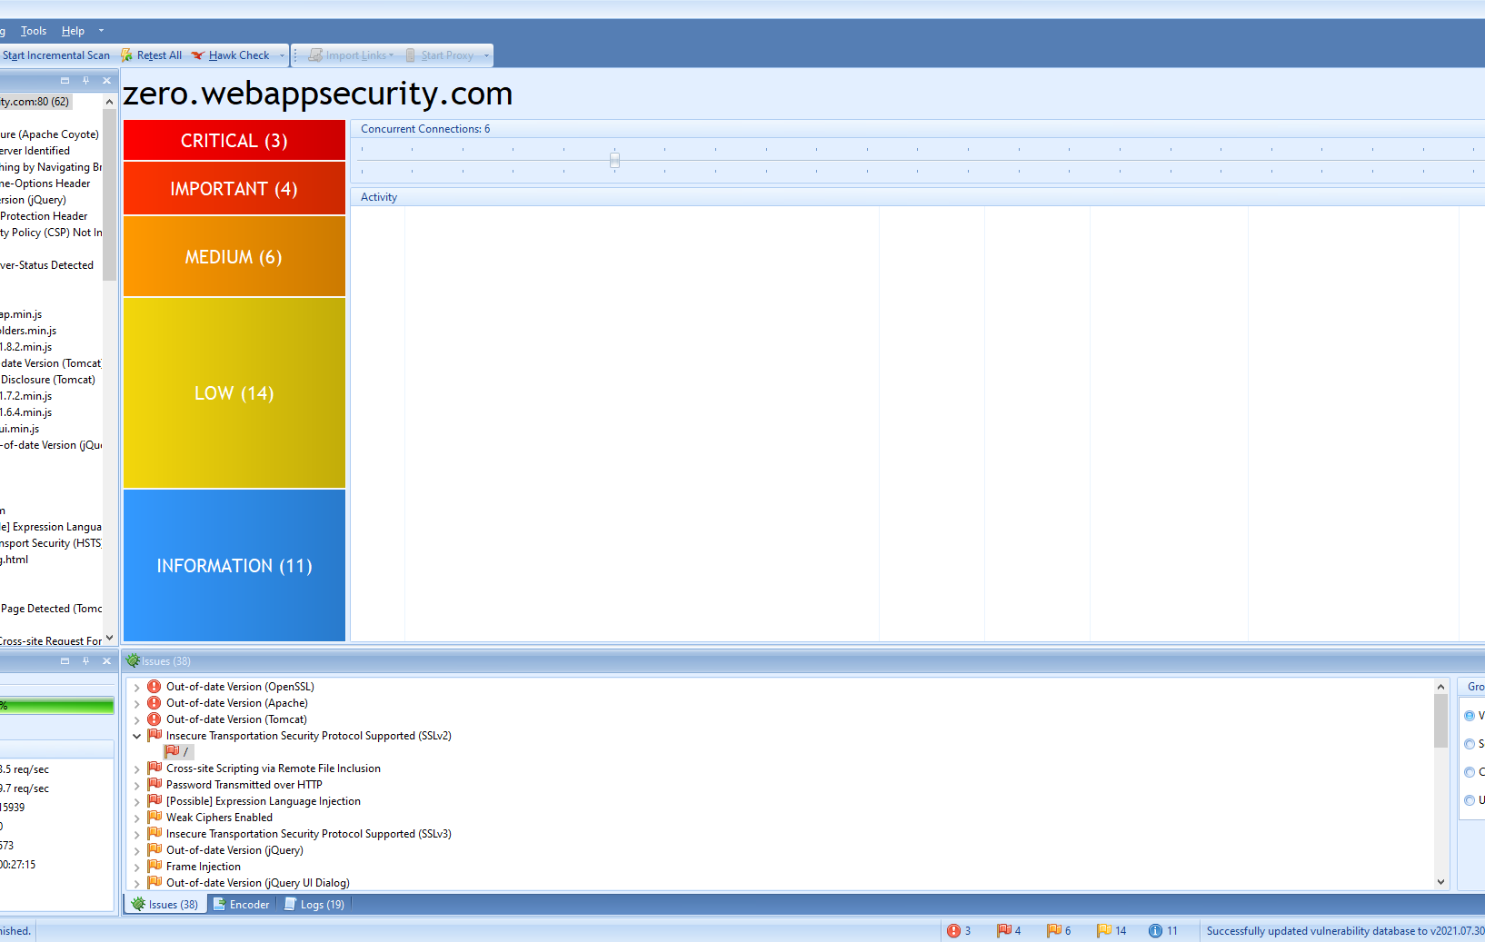
SCREENSHOT

Slide 3
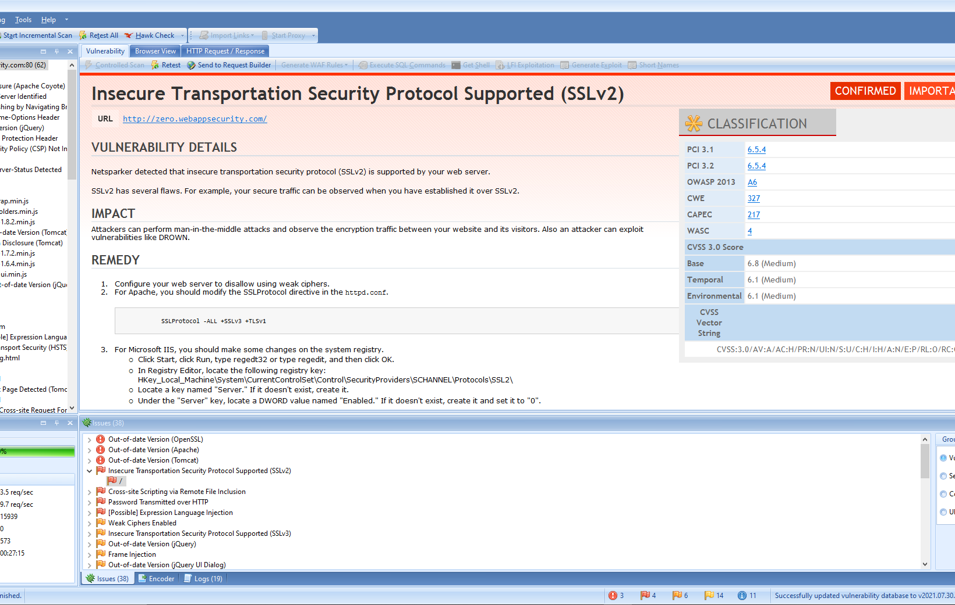
SCREENSHOT

Slide 4
REPORT:
**VULNERBILITY**
Enforce HTTPS: Ensure your web application uses HTTPS exclusively. Configure your web server to redirect all HTTP requests to HTTPS. This ensures data, including passwords, is encrypted during transmission.
HSTS (HTTP Strict Transport Security): Implement HSTS headers to instruct browsers to always use HTTPS when communicating with your site. This prevents downgrade attacks.
Mixed Content: Check for mixed content (HTTP resources loaded on an HTTPS page). Mixed content can weaken security. Fix any references to insecure resources (e.g., images, scripts) to use HTTPS.
Content Security Policy (CSP): Set up a CSP to restrict which resources can be loaded on your site. This helps prevent XSS attacks and ensures only secure content is loaded

Slide 5
THREAT :
HTTPS (Hypertext Transfer Protocol Secure) is indeed a secure protocol. It encrypts data transmitted between a user’s browser and a web server, ensuring confidentiality and integrity.
The encryption prevents unauthorized parties from intercepting sensitive information, such as passwords or credit card details, during transmission.
TLS (Transport Layer Security), which underlies HTTPS, provides robust encryption and authentication mechanisms. It’s widely used and trusted across the internet

Slide 6
WHAT CAN BE DONE AS SECURITY MEASURES :
Enforce HTTPS: Configure your web server to exclusively use HTTPS. This ensures that all data exchanged between the client (browser) and the server is encrypted.
HSTS (HTTP Strict Transport Security): Implement HSTS headers to instruct browsers to always use HTTPS when communicating with your site. This prevents downgrade attacks.
Mixed Content: Check for mixed content (HTTP resources loaded on an HTTPS page). Fix any references to insecure resources (e.g., images, scripts) to use HTTPS.
Content Security Policy (CSP): Set up a CSP to restrict which resources can be loaded on your site. This helps prevent XSS attacks and ensures only secure content is loaded.

Slide 7
WHERE THIS THREAT WAS FOUND :
URL :http://zero.webappsecurity.com/login.html
Input Name :new_password
Form target action :http://zero.webappsecurity.com/signin.html
HOW IT WAS DETECTED :
It was detected by an well known automatic vulnerability application
known as NETSPARKER

